Slide 1
Inter-temporal Choice
Geometric discounting

Slide 2
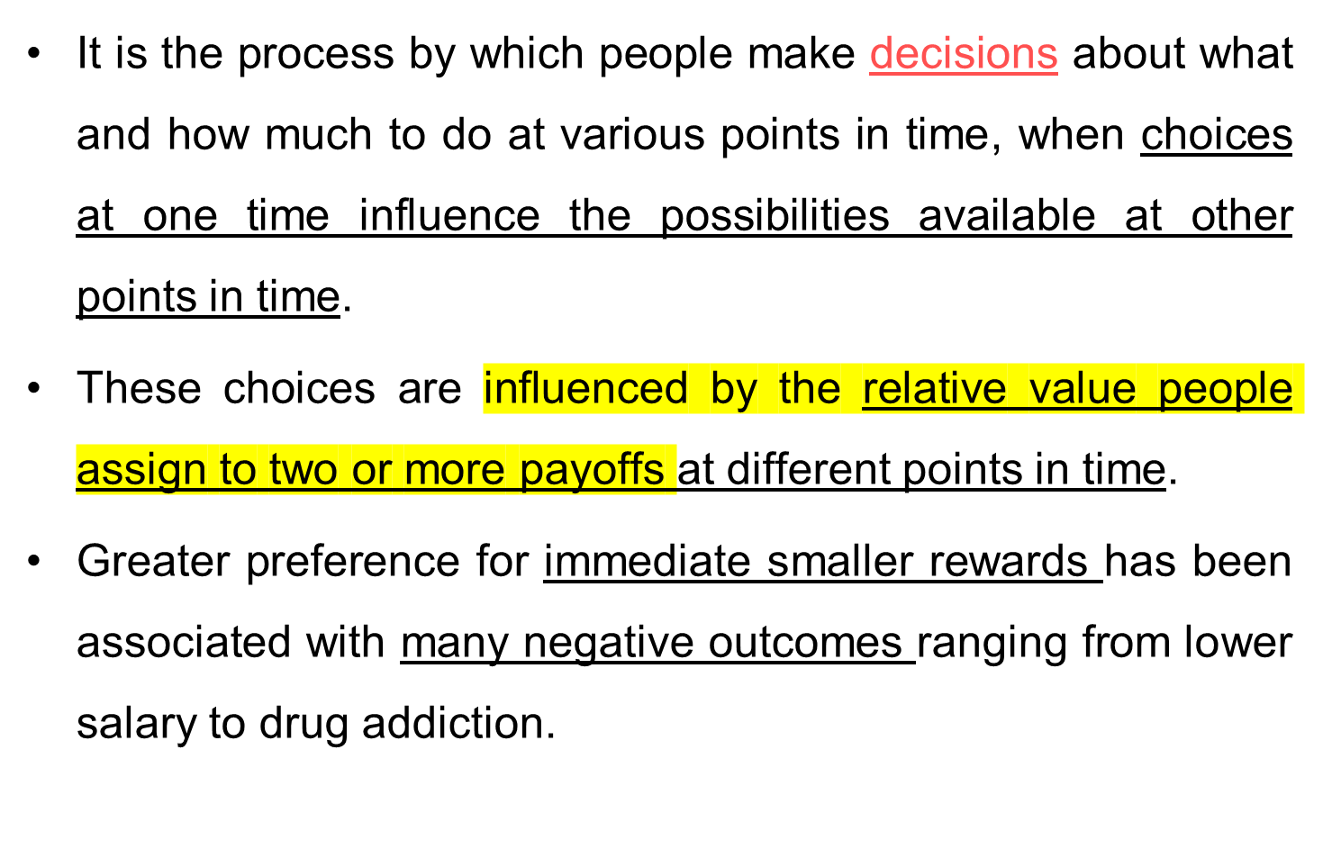
Inter-temporal Choice

Slide 3
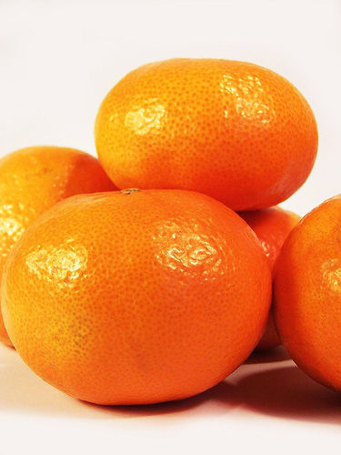
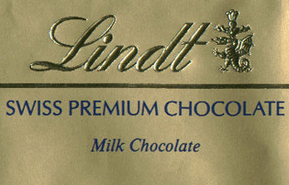
Read and van Leeuwen (1998)
Choosing Today
Eating Next Week
Time
If you were
deciding today,
would you choose
fruit or chocolate
for next week?

Slide 4
Patient choices for the future:
Choosing Today
Eating Next Week
Time
Today, subjects
typically choose
fruit for next week.
74%
choose
fruit

Slide 5
Impatient choices for today:
Choosing and Eating
Simultaneously
Time
If you were
deciding today,
would you choose
fruit or chocolate
for today?

Slide 6
Time Inconsistent Preferences:
Choosing and Eating
Simultaneously
Time
70%
choose
chocolate

Slide 7
Read, Loewenstein & Kalyanaraman (1999)
Choose among 24 movie videos
Some are “low brow”: Four Weddings and a Funeral
Some are “high brow”: Schindler’s List
Picking for tonight: 66% of subjects choose low brow.
Picking for next Saturday: 37% choose low brow.
Picking for second Saturday: 29% choose low brow.
Tonight I want to have fun… next week I want things that are good for me.

Slide 8
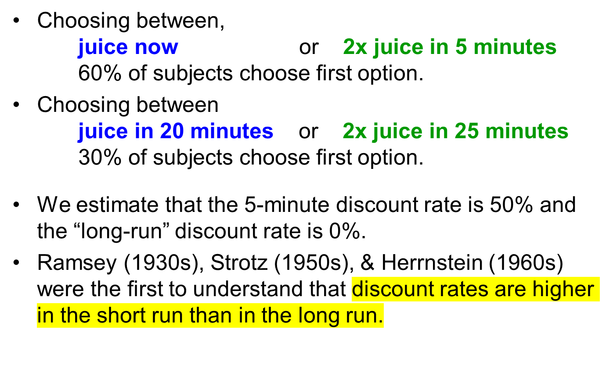
Extremely thirsty subjects
McClure, Ericson, Laibson, Loewenstein and Cohen (2007)

Slide 9
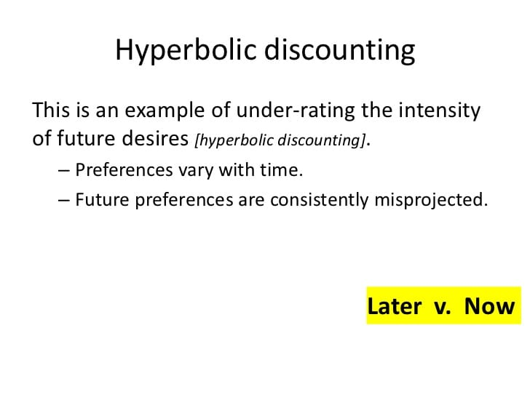

Slide 10
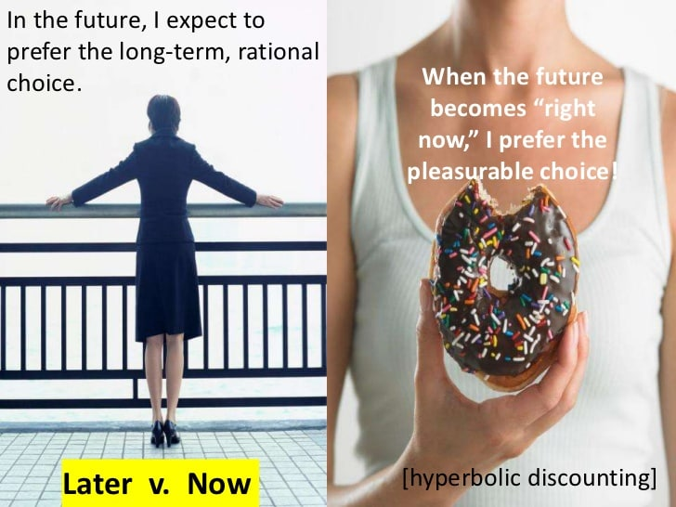

Slide 11
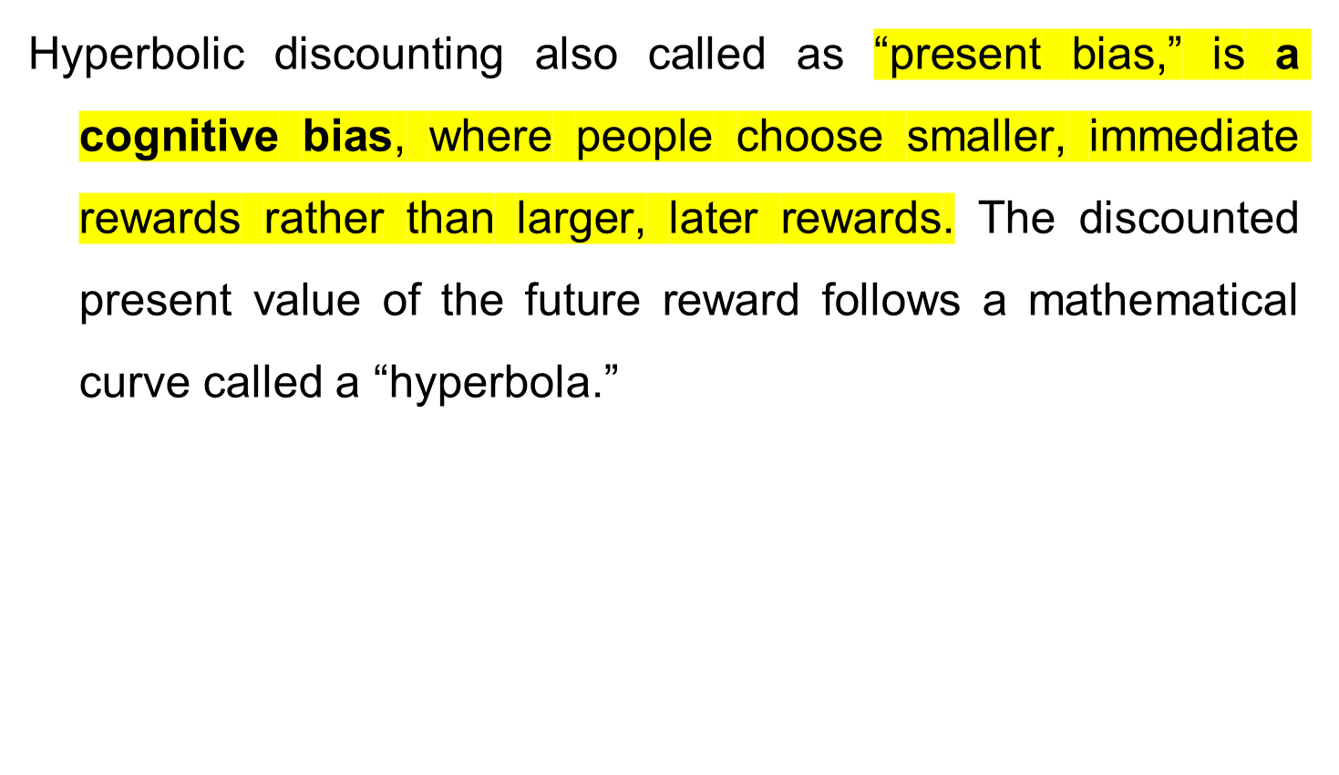
Continued...

Slide 12
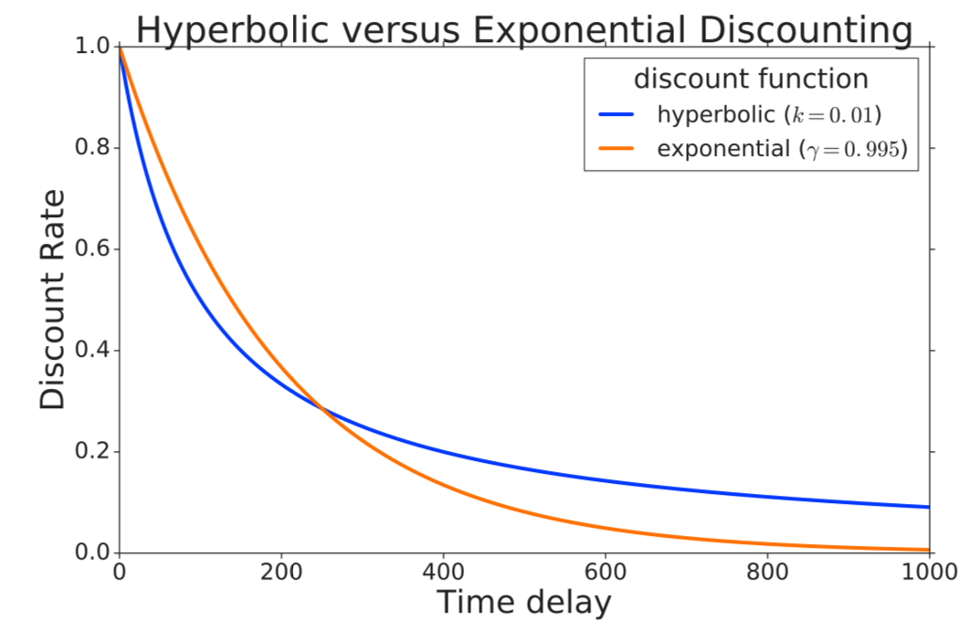

Slide 13
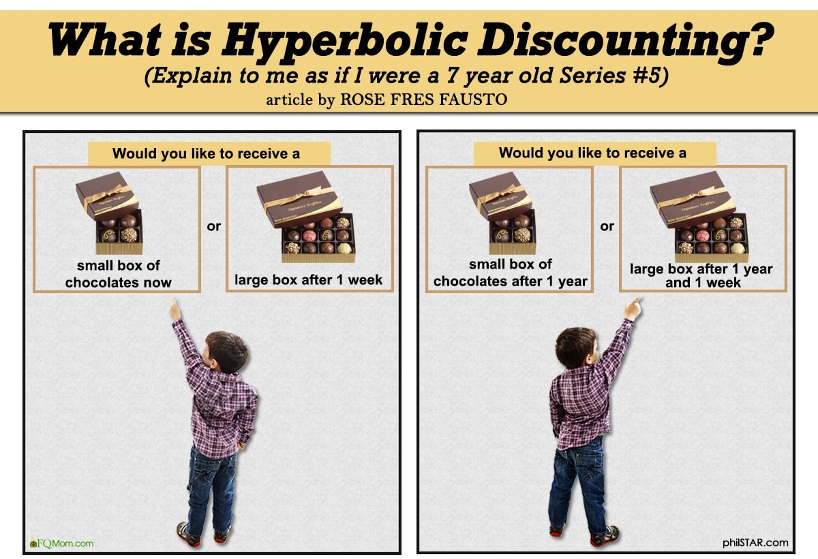

Slide 14
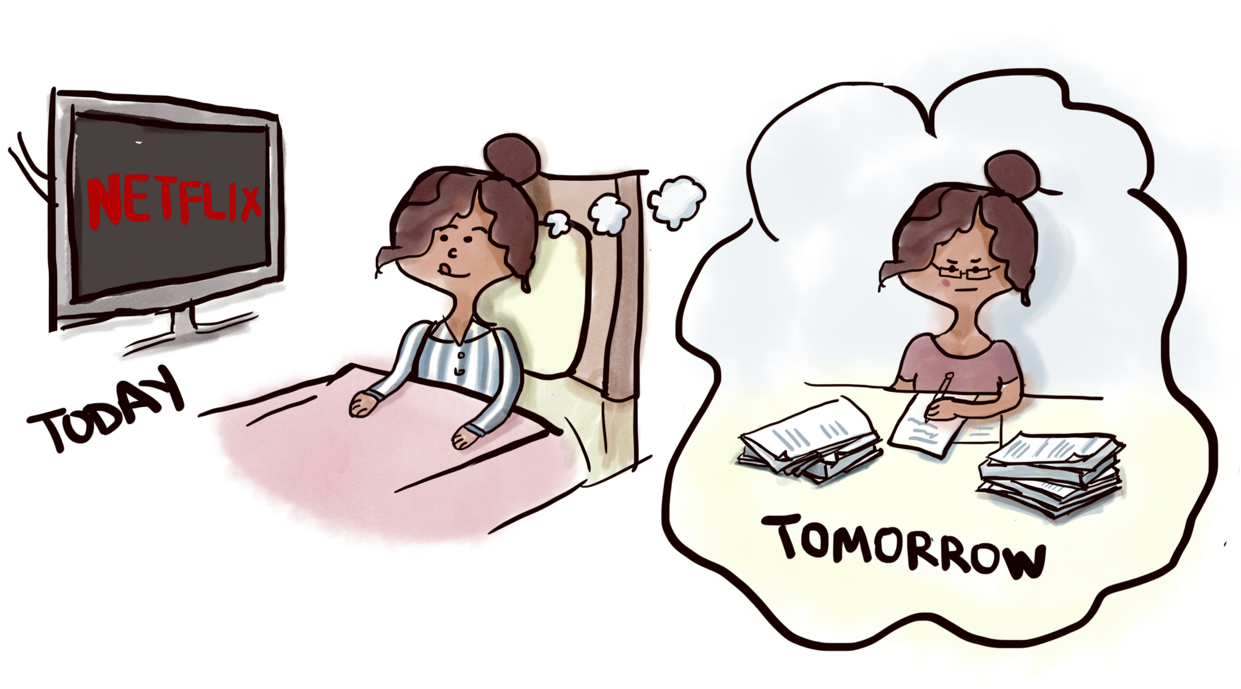

Slide 15
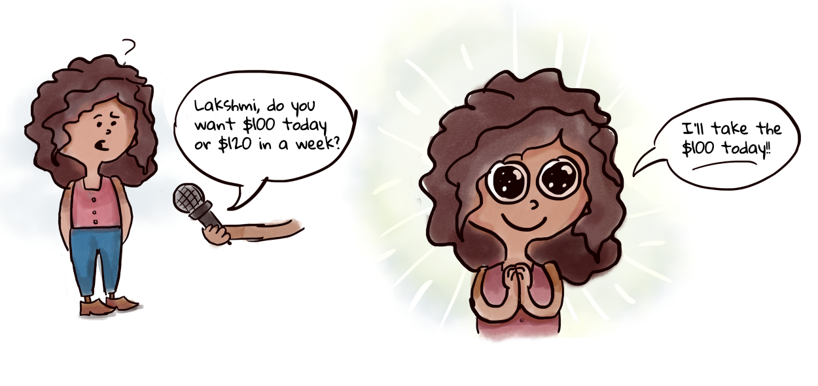

Slide 16
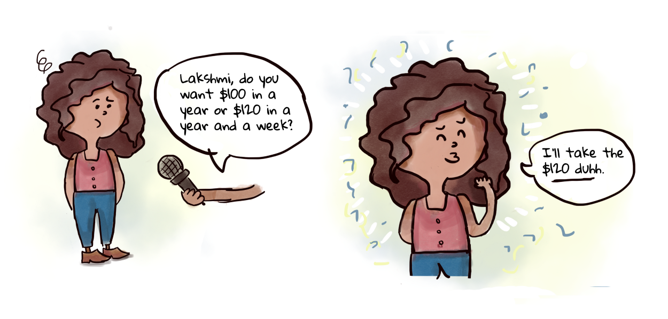

Slide 17
Continued...
A lot of important decisions that concern our health, wellness, financial security and careers are affected by hyperbolic discounting.
When you procrastinate, you opt for the instant gratification of enjoying yourself rather than the future reward of accomplishing the things you set out to do.
Cognitive biases are evolutionary shortcuts we use but don’t always work perfectly.

Slide 18
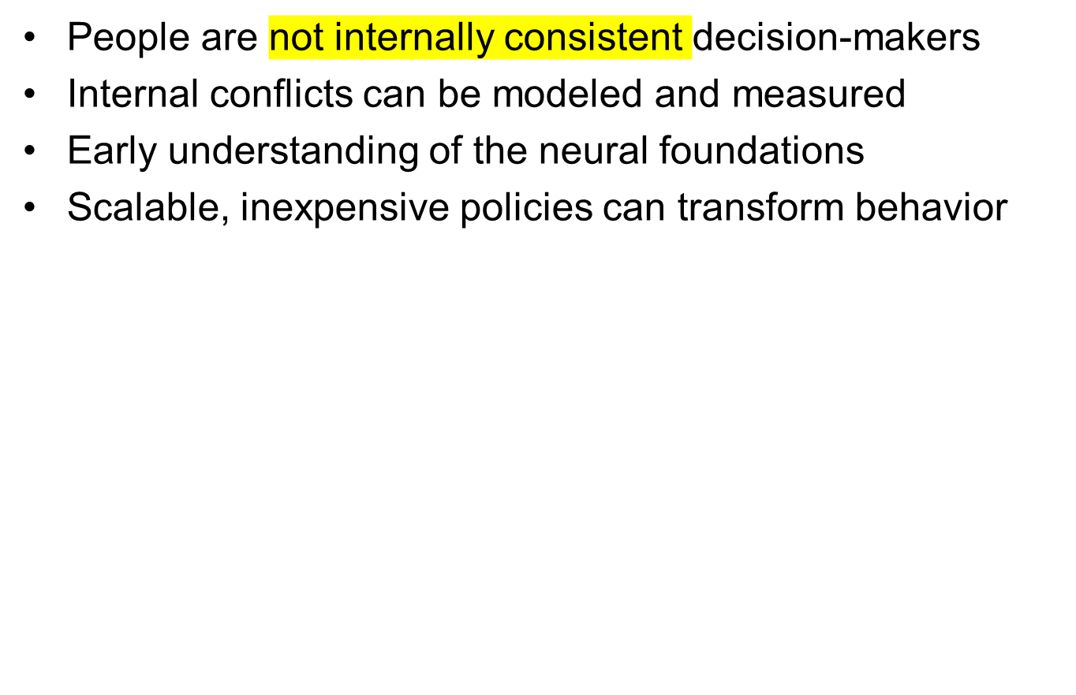
Concepts

Slide 19
Theoretical background
Classical functional form: exponential functions.
D(t) = δ^{t}
D(t) = 1, δ, δ², δ³, ...
U_{t} = u_{t} + δ u_{t+1} + δ² u_{t+2} + δ³ u_{t+3} + ...
But exponential function does not show instant gratification effect.
Discount function declines at a constant rate.
Discount function does not decline more quickly in the short-run than in the long-run.

Slide 20
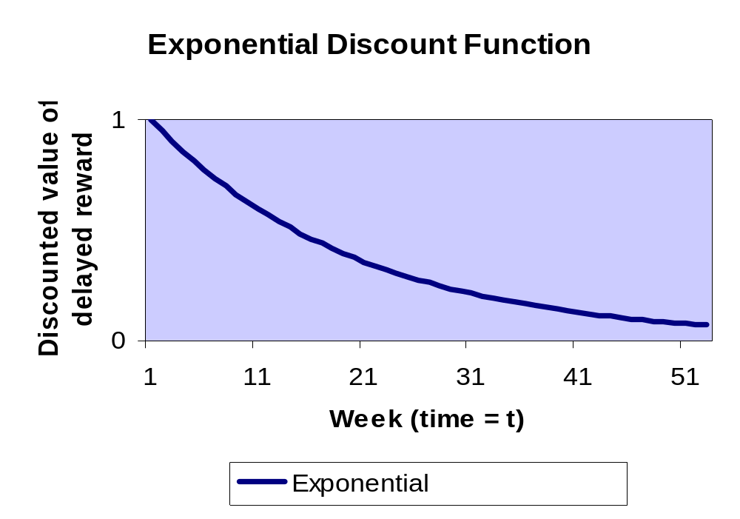

Slide 21
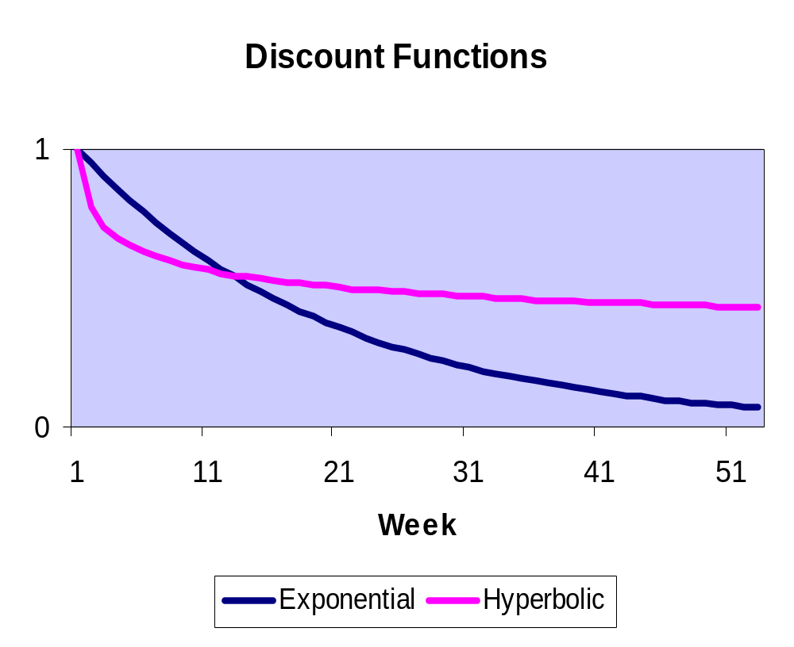
Slow rate of decline
in long run
Rapid rate
of decline
in short run

Slide 22
An exponential discounting paradox.
Suppose people discount at least 1% between today and tomorrow.
Suppose their discount functions were exponential.
Then 100 utils in t years are worth 100*e^{(-0.01)*365*t} utils today.
What is 100 today worth today? 100.00
What is 100 in a year worth today? 2.55
What is 100 in two years worth today? 0.07
What is 100 in three years worth today? 0.00

Slide 23
An Alternative Functional Form
Quasi-hyperbolic discounting
(Phelps and Pollak 1968, Laibson 1997)
D(t) = 1, βδ, βδ², βδ³, ...
U_{t} = u_{t} + βδu_{t+1} + βδ²u_{t+2} + βδ³u_{t+3} + ...
U_{t} = u_{t} + β [δu_{t+1} + δ²u_{t+2} + δ³u_{t+3} + ...]
β uniformly discounts all future periods.
exponentially discounts all future periods.
For continuous time: see Barro (2001), Luttmer and Marriotti (2003), and Harris and Laibson (2009)

Slide 24
Building intuition
To build intuition, assume that β = ½ and δ = 1.
Discounted utility function becomes
U_{t} = u_{t} + ½ [u_{t+1} + u_{t+2} + u_{t+3} + ...]
Discounted utility from the perspective of time t+1.
U_{t+1} = u_{t+1} + ½ [u_{t+2} + u_{t+3} + ...]
Discount function reflects dynamic inconsistency: preferences held at date t do not agree with preferences held at date t+1.

Slide 25
Exercise
Assume that β = ½ and δ = 1.
Suppose exercise (current effort 6) generates delayed benefits (health improvement 8).
Will you exercise?
Exercise Today: -6 + ½ [8] = -2
Exercise Tomorrow: 0 + ½ [-6 + 8] = +1
Agent would like to relax today and exercise tomorrow.
Agent won’t follow through without commitment.

Slide 26
3. Field Evidence
Della Vigna and Malmendier (2004, 2006)
Average cost of gym membership: $75 per month
Average number of visits: 4
Average cost per vist: $19
Cost of “pay per visit”: $10

Slide 27
Choi, Laibson, Madrian, Metrick (2002)
Self-reports about undersaving.
Survey
  Mailed to 590 employees (random sample)
  195 usable responses
  Matched to administrative data on actual savings behavior
Consider a population of 100 respondents
  68 report saving too little
  24 of 68 plan to raise 401(k) contribution in next 2 months
  Only 3 of 24 actually do so in the next 4 months
  Are self reports reliable?

Slide 28
Individual differences in measured discount rates
Smoking:
Relationship between cigarette smoking and discounting is explored by existing research studies,
Cigarette smoking is associated with higher discount rates.

Slide 29
Continued....
Excessive alcohol consumption:
Problematic drinking is associated with higher discount rates.
Heavy drinkers have higher discount rates than controls.
Active alcoholics discount rewards more than abstinent alcoholics, who in turn discount at higher rates than controls.

Slide 30
Continued....
Illicit drug use:
a positive association between discount rates and drug use for a variety of illicit drugs, most notably cocaine, crack-cocaine, heroin, and amphetamines

Slide 31
Continued....
Gambling
Pathological gamblers have higher discount rates than controls, both in the laboratory and in a more natural setting
Positive relationship between a gambling severity measure and the discount rate within a sample of problem gamblers.

Slide 32
Continued....
Age
Patience appears to increase across the lifespan, with the young showing markedly less patience than middle-aged and older adults.

Slide 33
Continued...
Cognitive Ability
Kirby, Winston and Santiesteban (2005) report that discount rates are correlated negatively with grade point average in two college samples.
Benjamin, Brown and Shapiro (2006) find an inverse relationship between individual discount rates and standardized (mathematics) test score scoring in the middle and lower thirds.

Slide 34
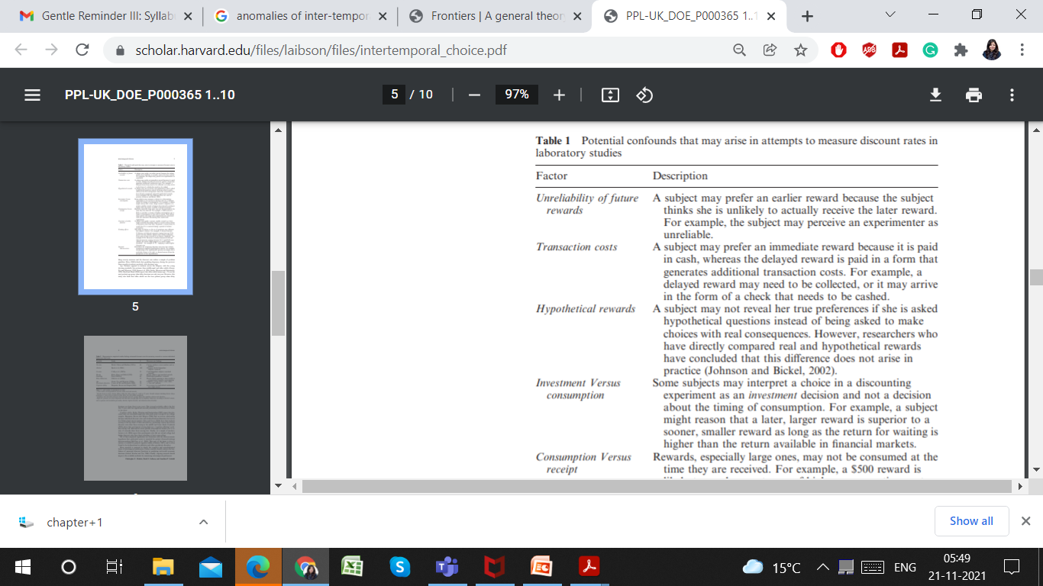

Slide 35
